Slide 1
System and Network Administration
Cryptography
Essentials

Slide 2
Secure Systems
1. Security policy
What needs to be protected
Kinds / level of protection
Responsibilities
Auditing policy
3. Security mechanisms
cryptography
authentication
security protocols
2. Security environment
Physical environment
Physical security
Hardware, operating system
firewalls, etc
4. Monitoring and auditing procedures
monitor access
audit trails
feedback on failures, security breaches
containment & recovery

Slide 3
Security Management
The security policy defines what information is to be protected and from whom
Security mechanisms implement aspects of the security policy, and their effectiveness must be monitored

Slide 4
Security Protocols
In practice, no single mechanism is adequate to address all goals, so a mix of mechanisms will be required to enforce security policies.
A protocol is an orderly sequence of steps that two or more parties follow in order to accomplish some joint task
e.g. protocols for
authentication of participants in an exchange of messages
data integrity checks
Encryption is a mechanism that can be incorporated into security protocols

Slide 5
Purpose
Cryptography is used to ensure
Confidentiality - symmetric, encrypt with public key [ data in transit, full disk encryption ]
Integrity - hash [ digital evidence ]
Availability - password hash (how is this different? crack target!)
Identity - digital signatures, pki [ software signing, communication security ]

Slide 6

Cryptography
The science of hiding information, most commonly by encoding and decoding a secret code used to send messages.
Based on mathematics and computer science.
Protects data in transit and data at rest.
data in use is in memory or being processed by the CPU, so it cannot be encrypted
Greetings, Mr. Logawps,
We received your request for information and will be happy to oblige. Here is your user name and password:
Encoding
Decoding
G7JDZL L59CZ2 AA9CZ1
ZPQ12G 93D2BA LP7FFH
18ABHF UJ14A3 34FYO5
K71TYP CS1314 566HXH

Slide 7
Cryptographic techniques
Encryption: Scrambling a message
Algorithm: Method used for scrambling
More formally: The algorithm is used to transform plaintext into cyphertext
Key: the output of certain encryption algorithms is controlled by a value called an encryption key

Slide 8




Algorithms
Confusion: encrypted data looks much different than the data we started with
Diffusion: changing one character of the original data makes the encrypted data look much different
The encryption key is used to help strengthen these mathematical properties of an algorithm
Original Information
Algorithm
Encrypted Information

Slide 9
A Key
A specific piece of information that is used in conjunction with an algorithm to perform encryption and decryption.
Different keys produce different ciphertext.
For each algorithm, longer keys provide stronger encryption.
Original Information
Algorithm
Encrypted Information

Slide 10




Slide 11
Cryptographic Techniques
Classes of algorithms:
Reversible, symmetric (Conventional)
Reversible, asymmetric (Public Key)
One-Way (Hash)
Properties of algorithms:
Reversible: can transform ciphertext back to plaintext
Symmetric: uses one key for both encryption and decryption
Asymmetric: uses different keys for encryption / decryption

Slide 12


Symmetric Encryption
A two-way encryption scheme in which encryption and decryption are both performed using the same key (shared key encryption).
Before encrypted communications begin, the key must be securely shared.
Fast, but vulnerable if the key is lost or compromised.
Common alternate names
Secret key
Shared key
Private key
Encrypts Data
Decrypts Data
Same Key on Both Sides

Slide 13
Symmetric, Reversible (Shared Key)
http://www.cryptool-online.org/index.php?option=com_content&view=article&id=47&Itemid=29&lang=en
ADFG(V)X
Alberti
AMSCO
Autokey
Beaufort
Bifid
Caesar / Rot-13
Enigma
Four-Square
Freemason
Gronsfeld
Hill
Kamasutra
Larrabee
Homophonic
Multiplicative
Navajo
Nihilist
Playfair
Pollux
Polybius
Porta
Rotation
Scytale
Templar
Transposition
Transposition
Trithemius
Vigenère
Zigzag (Rail Fence)
Classic Symmetric Cyphers
Invented for use by People

Slide 14
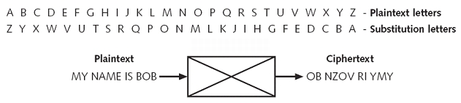
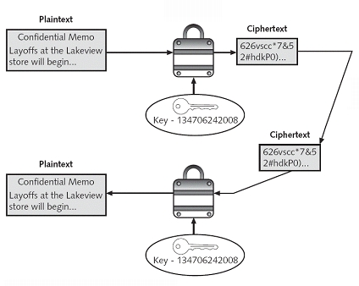
Substitution cipher: each unit of plaintext is kept in the same position, but its value is changed.
Need to know the
substitution alphabet
and the number of
iterations to decrypt
Need to know the algorithm and the secret key to decrypt
Notes:
14

Slide 15
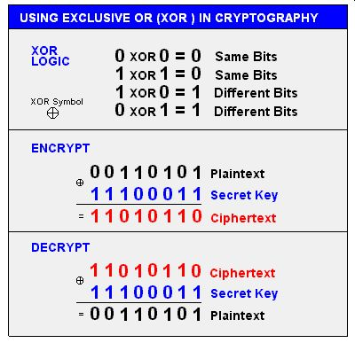
Bit level XOR
Any plaintext can be encrypted by applying the bitwise XOR operator to every character using a given key.
The XOR function is applied to the cyphertext with the same key to return the original plaintext.
XOR is quick, simple, and light on performance.
Commonly used to make malicious code difficult to analyze.

Slide 16
Bit level XOR
For unbreakable encryption, the key is the same length as the plain text message, and the key is made up of random bytes.
The user would keep the encrypted message and the encryption key in different locations, and without both "halves", it is impossible to decrypt the message.
If the key is shorter than the message, there is a pattern repeated cyclically throughout the message. This makes it easier to recover the plaintext because once one instance of the pattern is solved, all of them are solved the same way.
The balance for this method is to use a key that is long enough to make the pattern difficult but short enough to be memorable, and to use many characters from the available character set

Slide 18
Asymmetric Encryption
Asymmetric encryption: A two-way encryption scheme that uses paired public and private keys.
Private key: The component of asymmetric encryption that is kept secret by one party during two-way encryption.
Public key: The component of asymmetric encryption that can be accessed by anyone.
Key generation: The process of producing a public and private key pair by using a specific application.

Slide 19
Asymmetric Encryption (Cont.)
Uses a key pair (a,b)
What one key does, the other can undo
Either key can be used to encrypt a message - the other key is then used to decrypt it
The message cannot be decoded with the key that encoded it
The message can only be decoded by a matching key
Knowledge of one key does not allow the other to be deduced
Public key
Private key
What one key does, the other key will undo
Can use either key to encrypt
One key can be published while the other is kept secret and secure

Slide 20
Asymmetric, Reversible (Public Key)
Private Message
All devices can use a station’s public key to encrypt data to send to the station.
The receiving station decrypts the data using its own private key.
Assured Message
Sender uses private key to encrypt data
The receiving station decrypts the data using the sender’s public key.
If the private key is kept secure, cannot deny sending the message (non-repudiation)

Slide 21
Reversible Encryption
Symmetric
Shared key
Message
Encrypt
ρφωεκφσ
Shared key
Message
Decrypt
ρφωεκφσ
Public key
Public Key – the key is publicly known
Message
Encrypt
ρφωεκφσ
Asymmetric
Private key
Private Key – secret key
Message
Decrypt
ρφωεκφσ

Slide 22
Symmetric vs Asymmetric Key
Symmetric key
Asymmetric key
Typically both share
same key
Two separate keys: a public and a private key
Typically faster x100!
Typically slower
Examples:
DES, IDEA, RC5, AES, …
Examples:
RSA, ElGamal Encryption, ECC…
We will talk a lot more about this later (PKI) …

Slide 24
Hashing
Hashing: A process or function that transforms plaintext to ciphertext that cannot be directly decrypted.
Hash, hash value, or message digest: The value that results from hashing encryption.
Used in standard password authentication schemes.
Used in digital signatures.
Used for verifying file integrity.
Message
Digest
HASH FUNCTION
6TE3 13LO P429 HJL7 AVGN
08JN D1UL 4Y89 MM20 CSN7
10B7 552F Q8LW 80VT VX4Y
PLBZ FR3X TX53 LL01 5320
"Secret"
"Keep this secret"
HASH FUNCTION
VV30 542A 77VX X2TY UL34
JJLD 72WE R2E4 JOP7 N421
HJP4 EWQ1 HG8X LA91 00B1
SS75 5YFC M72A 9LQE 762A

Slide 25
/etc/shadow
When the system administrator sets up an account, the password is typed in for the first time. The system stores the encrypted password in a secure database.
User : Password : UID : GID : GCOS : Home : Shell
root:KnR8gQb3hDYg6:0:0:root:/root:/bin/bash
httpd:zYFuFaKw6ZovI:15:60:Apache_1.2.4:/home/httpd:/bin/bash
tomas:k6x5IqJcB1C.Q:500:500:TommyGun:/home/tomas:/bin/bash
guest:qfRc424I3/QGI:502:502:Guest User:/home/guest:/bin/pdmsh
jacob:dbBOzTSdCX5HU:503:503:Linux User:/home/jacob:/bin/bash
peterlai:T5RlEJUib7wOk:504:504:Linux User:/home/peterlai:/bin/bash
toshiba:DPz8cCRkIQc1Q:505:502:SLIP User:/home/rest:/usr/sbin/dip -i
victor:wiSml8WiVwJt2:506:506:Linux User:/home/victor:/bin/bash
dolphin:5JaZ7KmR7hEzM:508:507:Mail User:/home/dolphin:/usr/bin/pine
Each time the user logs in after that, the system encrypts the password that has been typed in and compares it to the cyphertext stored in the database.

Slide 26

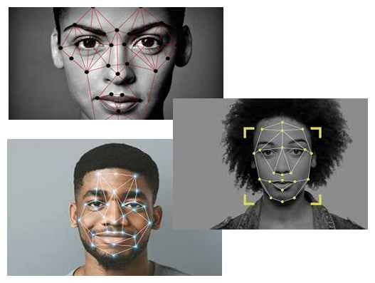
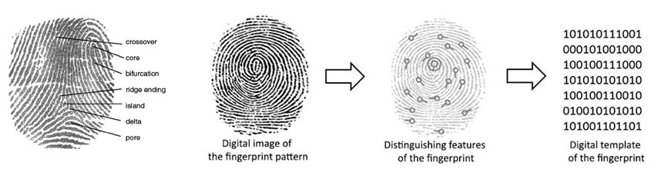
Biometric systems define a pattern for comparison
Similar to – but not the same as – a hash algorithm

Slide 28
Securing Encryption
Trying to keep the design of a security system secret as its only method of security is called security through obscurity.
You cannot safely assume that an eavesdropper doesn't have complete details of any/all encryption and decryption algorithms
Shannon’s Maxim (1949): Design systems under the assumption that the enemy will immediately gain full familiarity with them
A security protocol can be considered secure only if someone who knows all of the details of these algorithms is unable to recover a message without trying every possible key.
Kerckhoffs's principle (1883): A cryptosystem should be secure even if everything about the system, except the key, is public knowledge

Slide 29
Securing Encryption
The important feature of most cryptographic operations is that they are easy to perform if you have the right information and infeasible to perform if you don't have that information.
Ultimately, security rests on the infeasibility of trying all possible decryption-key values
Encryption systems must incorporate an element of randomness to ensure that each plaintext maps to one of a large number of possible ciphertexts
Strengthens the properties of Confusion and Diffusion

Slide 30
Types of Cryptographic Attacks
Cryptographic Attacks try to exploit weaknesses in encryption algorithms, protocols, and key-management systems.
Cryptographic Attack Type | Description
Downgrade attack | Attacker exploits the need for backward compatibility. Attacker forces a computer to abandon the use of encrypted messages in favor of plaintext messages.
Replay attack | Attacker intercepts session keys or authentication traffic. Attacker uses them later to authenticate and gain access.
Weak implementation attacks | Focus on how the cryptographic system is implemented. (Other cryptographic attacks focus on the algorithm used to encrypt the targeted data.)

Slide 31
Types of Cryptographic Attacks
Cryptographic Attack Type | Description
Known plaintext attack (KPA) | Attacker has a plaintext message and its corresponding ciphertext. Attacker tries to derive the correlation between them to determine the encryption key.
Chosen plaintext attack | Attacker encrypts a selected plaintext message. Attacker analyzes the resulting ciphertext to crack the cipher.
Ciphertext-only attack | Attacker has access to ciphertext. Attacker tries to use frequency analysis or other methods to break the cipher.
Chosen ciphertext attack | Attacker analyzes a selected ciphertext message and tries to find the matching plaintext.

Slide 32





Brute Force Attack: Attacker tries all possible combinations in an attempt to find the one you use.
Commonly used for passwords

Slide 33
Brute Force
For example:
A brute force attack must perform 2^128 trial decryptions to discover what a 128-bit key actually is.
However, there are only one million possible values for microseconds, resulting in only one million possible choices for the PRNG seed.
So if you know the 128 bits of the key actually came from a time value that you can guess plus/minus 1000 microseconds, then your search becomes 340282366920938463463374607431 times easier!
Testing all one million possibilities took about 25 seconds on an HP 712/80 in 1995, when the Netscape browser started using encryption to secure communications with webservers.
Randomness in cryptography is still a very active research area.
Ian Goldberg and David Wagner, Randomness and the Netscape Browser Dr. Dobb's Journal January 1996
https://people.eecs.berkeley.edu/~daw/papers/ddj-netscape.html

Slide 35
Application developers need not become experts in cryptography to be able to use cryptography in their applications.
They simply use an application programming interface (API) to a cryptography module (library).
Programmers don’t have to worry what the implementation of the cryptography, they only have to understand how to provide plaintext or cyphertext to the API and get the answer back from the API.

Slide 36
Similarly, there is no point in knowing a lot of algorithm names
There are hundreds of symmetric and hash algorithms (not so many asymmetric) from the past, and more coming in the future
The important thing to do is to find out if a particular algorithm is currently considered secure. This list changes over time, and getting an expert opinion is only sensible

